Slide 1

Jesus Promises to Protect His Church
Matthew 16:18
Notes:
Eddie Williams ~ September 9, 2026

Slide 2
Matthew 16:18 (NASB)
I also say to you that you are Peter, and upon this rock I will build My church; and the gates of Hades will not overpower it.

Slide 3
The concept of God defending His Church is a recurring theme throughout the Bible, emphasizing His protection, guidance, and provision for His people.

Slide 4
The Church, often referred to as the Body of Christ, is depicted as being under the divine guardianship of God, who acts as its protector against spiritual and earthly adversities.

Slide 5
Old Testament Foundations:
The Old Testament lays the groundwork for understanding God's protective nature over His people, which extends to the Church in the New Testament. In the Psalms, we find numerous references to God as a defender and shield.

Slide 6
Psalm 46:1-2 declares, "God is our refuge and strength, an ever-present help in times of trouble. Therefore, we will not fear, though the earth is transformed and the mountains are toppled into the depths of the seas." This passage illustrates the steadfastness of God's protection, a promise that extends to His Church.

Slide 7
New Testament Assurance:
In the New Testament, the Church is established as the continuation of God's covenant people, and His protective promises are reaffirmed. Jesus Christ, the head of the Church, assures His followers of divine protection.

Slide 8
In Matthew 16:18, Jesus states, "And I tell you that you are Peter, and on this rock I will build My church, and the gates of Hades will not prevail against it." This declaration underscores the invincibility of the Church under God's defense.

Slide 9
Christ is King of His Kingdom and Head of His Church

Slide 10
Matthew 16:18-19 (NASB)
¹⁸ "I also say to you that you are Peter, and upon this rock I will build My church; and the gates of Hades will not overpower it.

Slide 11
Matthew 16:18-19 (NASB)
¹⁹ "I will give you the keys of the kingdom of heaven; and whatever you bind on earth shall have been bound in heaven, and whatever you loose on earth shall have been loosed in heaven."

Slide 12
Ephesians 2:19-22 (NASB)
¹⁹ So then you are no longer strangers and aliens, but you are fellow citizens with the saints, and are of God's household, ²⁰ having been built on the foundation of the apostles and prophets, Christ Jesus Himself being the corner stone,

Slide 13
Ephesians 2:19-22 (NASB)
²¹ in whom the whole building, being fitted together, is growing into a holy temple in the Lord, ²² in whom you also are being built together into a dwelling of God in the Spirit.

Slide 14
Colossians 1:18 (NASB)
He is also head of the body, the church; and He is the beginning, the firstborn from the dead, so that He Himself will come to have first place in everything.

Slide 15
I Timothy 3:15 (NASB)
but in case I am delayed, I write so that you will know how one ought to conduct himself in the household of God, which is the church of the living God, the pillar and support of the truth.

Slide 16
The Gates of Hell Cannot Overcome Christ’s Church

Slide 17
Hebrews 12:28 (NASB)
Therefore, since we receive a kingdom which cannot be shaken, let us show gratitude, by which we may offer to God an acceptable service with reverence and awe;

Slide 18
Daniel 2:44 (NASB)
"In the days of those kings the God of heaven will set up a kingdom which will never be destroyed, and that kingdom will not be left for another people; it will crush and put an end to all these kingdoms, but it will itself endure forever.

Slide 19
Daniel 7:18 (NASB)
'But the saints of the Highest One will receive the kingdom and possess the kingdom forever, for all ages to come.'

Slide 20
Jesus Loves and Cares for His Church

Slide 21
Ephesians 5:25-27 (NASB)
²⁵ Husbands, love your wives, just as Christ also loved the church and gave Himself up for her, ²⁶ so that He might sanctify her, having cleansed her by the washing of water with the word,

Slide 22
Ephesians 5:25-27 (NASB)
²⁷ that He might present to Himself the church in all her glory, having no spot or wrinkle or any such thing; but that she would be holy and blameless.

Slide 23
Ephesians 5:29 (AMPC)
For no man ever hated his own flesh, but nourishes and carefully protects and cherishes it, as Christ does the church,

Slide 24
Matthew 11:28-30 (NASB)
²⁸ "Come to Me, all who are weary and heavy-laden, and I will give you rest. ²⁹ "Take My yoke upon you and learn from Me, for I am gentle and humble in heart, and YOU WILL FIND REST FOR YOUR SOULS.³⁰ "For My yoke is easy and My burden is light."

Slide 25
Satan Has Put Tares in the Church, Leave Them Alone

Slide 26
Matthew 13:24-30 (NASB)
²⁴ Jesus presented another parable to them, saying, "The kingdom of heaven may be compared to a man who sowed good seed in his field.²⁵ "But while his men were sleeping, his enemy came and sowed tares among the wheat, and went away.

Slide 27
Matthew 13:24-30 (NASB)
²⁶ "But when the wheat sprouted and bore grain, then the tares became evident also. ²⁷ "The slaves of the landowner came and said to him, 'Sir, did you not sow good seed in your field? How then does it have tares?’

Slide 28
Matthew 13:24-30 (NASB)
²⁸ "And he said to them, 'An enemy has done this!' The slaves said to him, 'Do you want us, then, to go and gather them up?’ ²⁹ "But he said, 'No; for while you are gathering up the tares, you may uproot the wheat with them.

Slide 29
Matthew 13:24-30 (NASB)
³⁰ 'Allow both to grow together until the harvest; and in the time of the harvest I will say to the reapers, "First gather up the tares and bind them in bundles to burn them up; but gather the wheat into my barn."'"

Slide 30
II Timothy 2:24-26 (NASB)
²⁴ The Lord's bond-servant must not be quarrelsome, but be kind to all, able to teach, patient when wronged, ²⁵ with gentleness correcting those who are in opposition,

Slide 31
II Timothy 2:24-26 (NASB)
if perhaps God may grant them repentance leading to the knowledge of the truth, ²⁶ and they may come to their senses and escape from the snare of the devil, having been held captive by him to do his will.

Slide 32
God Will Repay; Vengeance is Mine

Slide 33
Romans 12:14-19 (NASB)
¹⁴ Bless those who persecute you; bless and do not curse.
¹⁵ Rejoice with those who rejoice, and weep with those who weep.

Slide 34
Romans 12:14-19 (NASB)
¹⁶ Be of the same mind toward one another; do not be haughty in mind, but associate with the lowly. Do not be wise in your own estimation.

Slide 35
Romans 12:14-19 (NASB)
¹⁷ Never pay back evil for evil to anyone. Respect what is right in the sight of all men.
¹⁸ If possible, so far as it depends on you, be at peace with all men.

Slide 36
Romans 12:14-19 (NASB)
¹⁹ Never take your own revenge, beloved, but leave room for the wrath of God, for it is written, "VENGEANCE IS MINE, I WILL REPAY," says the Lord.

Slide 37
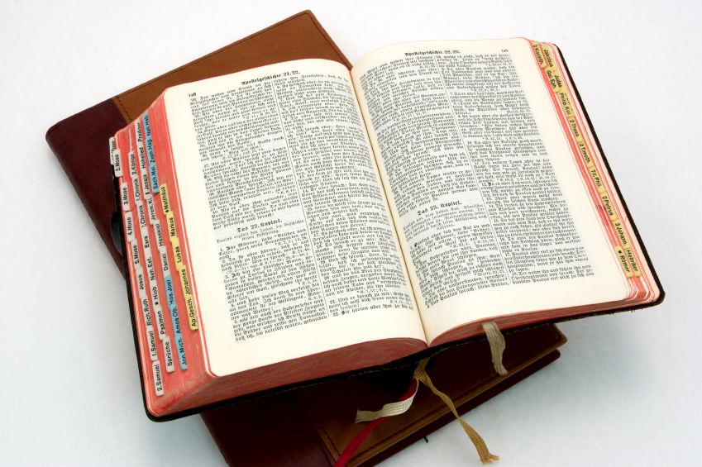
Hear: Romans 10:17
So then faith cometh by hearing, and hearing by the word of God.

Slide 38
Believe: Hebrews 11:6
But without faith it is impossible to please him: for he that cometh to God must believe that he is, and that he is a rewarder of them that diligently seek him.

Slide 39
Repent: Luke 13:3
I tell you, Nay: but, except ye repent, ye shall all likewise perish.

Slide 40
Confess: Matthew 10:32-33
32 Whosoever therefore shall confess me before men, him will I confess also before my Father which is in heaven.
33 But whosoever shall deny me before men, him will I also deny before my Father which is in heaven.

Slide 41
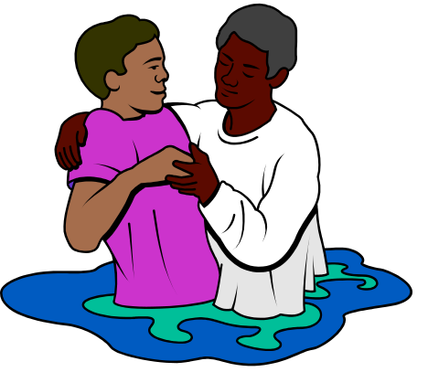
Baptize: Acts 22:16
And now why tarriest thou? arise, and be baptized, and wash away thy sins, calling on the name of the Lord.

